Slide 1
Introduction to quantitative and qualitative research
Dr Liz FitzGerald Institute of Educational Technology

Slide 2
Research and research methods
Research methods are split broadly into quantitative and qualitative methods
Which you choose will depend on
your research questions
your underlying philosophy of research
your preferences and skills

Slide 3
Basic principles of research design
Four main features of research design, which are distinct, but closely related
Ontology: How you, the researcher, view the world and the assumptions that you make about the nature of the world and of reality
Epistemology: The assumptions that you make about the best way of investigating the world and about reality
Methodology: The way that you group together your research techniques to make a coherent picture
Methods and techniques: What you actually do in order to collect your data and carry out your investigations
These principles will inform which methods you choose: you need to understand how they fit with your ‘bigger picture’ of the world, and how you choose to investigate it, to ensure that your work will be coherent and effective

Slide 4
Four main schools of ontology (how we construct reality)
Ontology | Realism | Internal Realism | Relativism | Nominalism
Summary | The world is ‘real’, and science proceeds by examining and observing it | The world is real, but it is almost impossible to examine it directly | Scientific laws are basically created by people to fit their view of reality | Reality is entirely created by people, and there is no external ‘truth’
Truth | There is a single truth | Truth exists, but is obscure | There are many truths | There is no truth
Facts | Facts exist, and can be revealed through experiments | Facts are concrete, but cannot always be revealed | Facts depend on the viewpoint of the observer | Facts are all human creations
However, none of these positions are absolutes. They are on a continuum, with overlaps between them.

Slide 5
Epistemology
i.e. the way in which you choose to investigate the world
Two main schools are positivism and social constructionism:
Positivists believe that the best way to investigate the world is through objective methods, such as observations. Positivism fits within a realist ontology.
Social constructionists believe that reality does not exist by itself. Instead, it is constructed and given meaning by people. Their focus is therefore on feelings, beliefs and thoughts, and how people communicate these. Social constructionism fits better with a relativist ontology.

Slide 6
Methodology
Epistemology and ontology will have implications for your methodology
Realists tend to have positivist approach → tend to gather quantitative sources of data
Relativists tend to have a social constructionist approach → tend to gather qualitative sources of data
Remember these are not absolutes! People tend to work on a continuum → role for mixed methods and approaches
Also consider the role of the researcher*: internal/external; involved or detached?
* See also Adams, Anne; FitzGerald, Elizabeth and Priestnall, Gary (2013). Of catwalk technologies and boundary creatures. ACM Transactions on Computer-Human Interaction (TOCHI), 20(3), article no. 15. http://oro.open.ac.uk/35323/

Slide 7
A note about data
Quantitative data is about quantities, and therefore numbers
Qualitative data is about the nature of the thing investigated, and tends to be words rather than numbers
Difference between primary and secondary data sources
Be aware of research data management practices and archives of data sets (both in terms of downloading and uploading)
Notes:
The Role of the Researcher
The researcher can be either involved, or external, detached.
These two positions, again, tend to link to the ontology and epistemology, with the positivist approach leading to a detached view, and the social constructionists tending towards the researcher being part of the world and therefore influencing, and being influenced by, events.
Choices and Trade-Offs
The choice of any particular research design, from ontology, through epistemology to methodology and then methods and techniques, involves trade-offs.
All of the main research traditions have strengths and weaknesses.
The most important aspect of designing your research is what you want to find out. Whatever methods you use, together with their underpinning philosophy, must answer your chosen research questions.
Find more at: http://www.skillsyouneed.com/learn/research-methods.html#ixzz40KrH4t80

Slide 8
Choosing your approach
Your approach may be influenced by your colleagues’ views, your organisation’s approach, your supervisor’s beliefs, and your own experience
There is no right or wrong answer to choosing your research methods
Whatever approach you choose for your research, you need to consider five questions:
What is the unit of analysis? For example, country, company or individual.
Are you relying on universal theory or local knowledge? i.e. will your results be generalisable, and produce universally applicable results, or are there local factors that will affect your results?
Will theory or data come first? Should you read the literature first, and then develop your theory, or will you gather your data and develop your theory from that? (N.B. this will likely be an iterative process)
Will your study be cross-sectional or longitudinal? Are you looking at one point in time, or changes over time?
Will you verify or falsify a theory? You cannot conclusively prove any theory; the best that you can do is find nothing that disproves it. It is therefore easier to formulate a theory that you can try to disprove, because you only need one ‘wrong’ answer to do so.

Slide 9
Quantitative approaches
Attempts to explain phenomena by collecting and analysing numerical data
Tells you if there is a “difference” but not necessarily why
Data collected are always numerical and analysed using statistical methods
Variables are controlled as much as possible (RCD as the gold standard) so we can eliminate interference and measure the effect of any change
Randomisation to reduce subjective bias
If there are no numbers involved, its not quantitative
Some types of research lend themselves better to quant approaches than others

Slide 10
Quantitative data
Data sources include
Surveys where there are a large number of respondents (esp where you have used a Likert scale)
Observations (counts of numbers and/or coding data into numbers)
Secondary data (government data; SATs scores etc)
Analysis techniques include hypothesis testing, correlations and cluster analysis

Slide 11
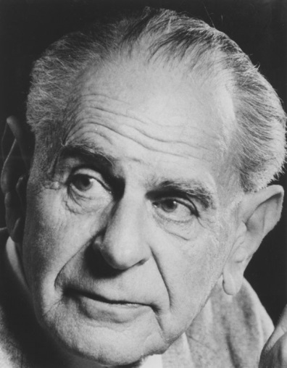

Black swans and falsifiability
Falsifiability or refutability of a statement, hypothesis, or theory is the inherent possibility that it can be proven false
Karl Popper and the black swan; deductive c.f. inductive reasoning
https://www.flickr.com/photos/lselibrary/ IMAGELIBRARY/5
Hypothesis testing
Start with null hypothesis i.e. H₀ – that there will be no difference
CC BY-SA 3.0, https://commons.wikimedia.org/w/index.php?curid=1243220
Notes:
Popper uses falsification as a criterion of demarcation to draw a sharp line between those theories that are scientific and those that are unscientific.
The classical view of the philosophy of science is that it is the goal of science to prove hypotheses like "All swans are white" or to induce them from observational data. Popper argued that this would require the inference of a general rule from a number of individual cases, which is inadmissible in deductive logic.^{[2]:4} However, if one finds one single swan that is not white, deductive logic admits the conclusion that the statement that all swans are white is false. Falsificationism thus strives for questioning, for falsification, of hypotheses instead of proving them.
For a statement to be questioned using observation, it needs to be at least theoretically possible that it can come in conflict with observation. A key observation of falsificiationism is thus that a criterion of demarcation is needed to distinguish those statements that can come in conflict with observation and those that cannot (Chorlton, 2012). Popper chose falsifiability as the name of this criterion.

Slide 12
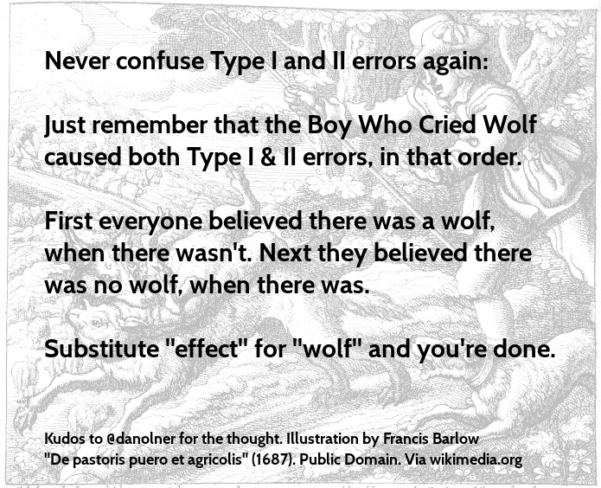
Type I and Type II errors
Notes:
Have I made any Type I (false positive – i.e. rejecting null hypothesis incorrectly) or Type II errors (false negative – i.e. rejecting alternate hypothesis incorrectly)?

Slide 13
Analysing quant data
Always good to group and/or visualise the data initially → outliers/cleaning data
What average are you looking for? Mean, median or mode?
Spread of data:
skewness/distribution
range, variance and standard deviation
Notes:
When most people say average, they are talking about the mean. It has the advantage that it uses all the data values obtained and can be used for further statistical analysis. However, it can be skewed by ‘outliers’, values which are atypically large or small.
As a result, researchers sometimes use the median instead. This is the mid-point of all the data. The median is not skewed by extreme values, but it is harder to use for further statistical analysis.
The mode is the most common value in a data set. It cannot be used for further statistical analysis.
The values of mean, median and mode are not the same, which is why it is really important to be clear which ‘average’ you are talking about.
The range is the difference between the largest and smallest values. Researchers often quote the interquartile range, which is the range of the middle half of the data, from 25%, the lower quartile, up to 75%, the upper quartile, of the values (the median is the 50% value). To find the quartiles, use the same procedure as for the median, but take the quarter- and three-quarter-point instead of the mid-point.
The standard deviation measures the average spread around the mean, and therefore gives a sense of the ‘typical’ distance from the mean.
The variance is the square of the standard deviation. They are calculated by:
calculating the difference of each value from the mean;
squaring each one (to eliminate any difference between those above and below the mean);
summing the squared differences;
dividing by the number of items minus one.
This gives the variance.
To calculate the standard deviation, take the square root of the variance.
Find more at: http://www.skillsyouneed.com/num/simple-statistical-analysis.html#ixzz40Puk0Bhw

Slide 14
What are you looking for?
Trying to find the signal from the noise
Generally, either a difference (between/within groups) or a correlation
Choosing the right test to use: parametric vs non-parametric (depends what sort of data you have – interval/ratio vs nominal/ordinal and how it is distributed)
Correlation does not imply causation!
Notes:
If you get it wrong you risk using an incorrect statistical procedure or you may use a less powerful procedure.
Non-paramteric statistical procedures are less powerful because they use less information in their calulation. For example, a parametric correlation uses information about the mean and deviation from the mean while a non-parametric correlation will use only the ordinal position of pairs of scores.
The basic distinction for paramteric versus non-parametric is:
If your measurement scale is nominal or ordinal then you use non-parametric statistics
If you are using interval or ratio scales you use parametric statistics.
There are other considerations which have to be taken into account:
You have to look at the distribution of your data. If your data is supposed to take parametric stats you should check that the distributions are approximately normal.The best way to do this is to check the skew and Kurtosis measures from the frequency output from SPSS. For a relatively normal distribution:
skew ~= 1.0 kurtosis~=1.0
If a distribution deviates markedly from normality then you take the risk that the statistic will be inaccurate. The safest thing to do is to use an equivalent non-parametric statistic.
www.csse.monash.edu.au/~smarkham/resources/scaling.htm - Nominal, ordinal etc.

Slide 15
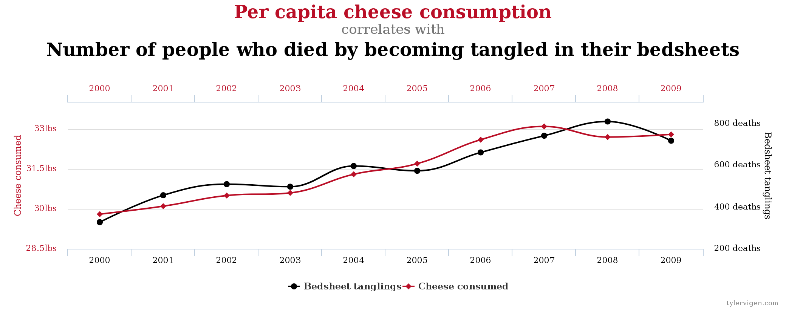
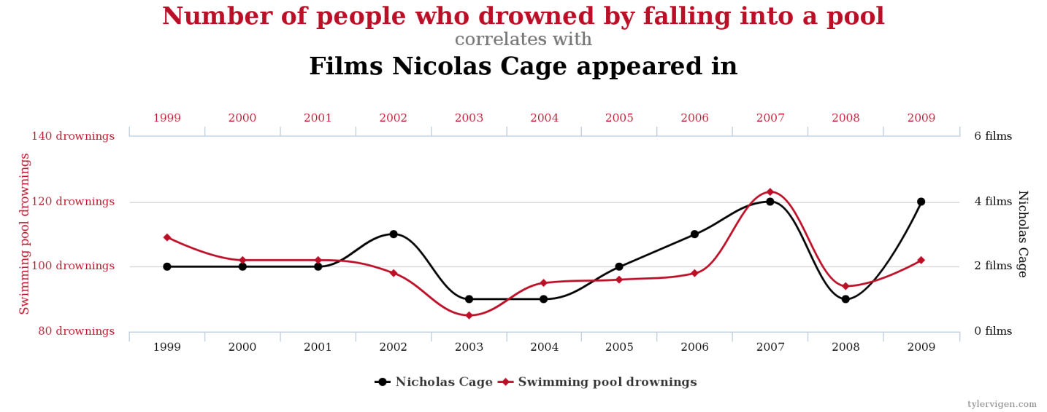
Example correlations
From ‘Spurious correlations’ website http://www.tylervigen.com/spurious-correlations

Slide 16
Interpreting test statistics
Significance level – a fixed probability of wrongly rejecting the null hypothesis H₀, if it is in fact true. Usually set to 0.05 (5%).
p value - probability of getting a value of the test statistic as extreme as or more extreme than that observed by chance alone, if the null hypothesis H₀, is true.
Power – ability to detect a difference if there is one
Effect size – numerical way of expressing the strength or magnitude of a reported relationship, be it causal or not
Notes:
Significance level of a statistical hypothesis test is a fixed probability of wrongly rejecting the null hypothesis H0, if it is in fact true.
The probability value (p-value) of a statistical hypothesis test is the probability of getting a value of the test statistic as extreme as or more extreme than that observed by chance alone, if the null hypothesis H0, is true.
Small p-values suggest that the null hypothesis is unlikely to be true. The smaller it is, the more convincing is the rejection of the null hypothesis. It indicates the strength of evidence for say, rejecting the null hypothesis H0, rather than simply concluding "Reject H0' or "Do not reject H0".
The power of a statistical hypothesis test measures the test's ability to reject the null hypothesis when it is actually false - that is, to make a correct decision. Ability to detect a difference.

Slide 17
Example of quant data/analysis*
Matched users were those who learning styles were matched with the lesson plan e.g. sequential users with a sequential lesson plan. Mismatched participants used a lesson plan that was not matched to their learning style, e.g. sequential users with a global lesson plan.
H₀ – there will be no statistically significant difference in knowledge gained between users from different experimental groups
H₁ – students who learn in a matched environment will learn significantly better than those who are in mismatched environment
H₂ – students who learn in a mismatched environment will learn significantly worse than those who learn in a matched environment
* Case study taken from: Brown, Elizabeth (2007) The use of learning styles in adaptive hypermedia. PhD thesis, University of Nottingham. http://eprints.nottingham.ac.uk/10577/

Slide 18
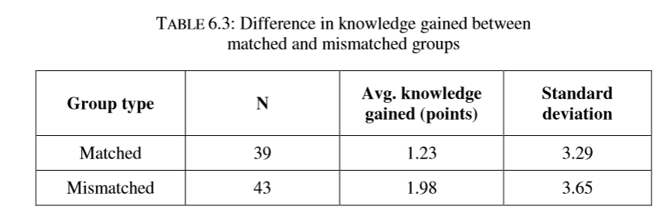
Interpreting test statistics
Statistical testing was carried out using a univariate ANOVA in SPSS, to determine if there was any significant difference in knowledge gained.
Initial conjecture suggests that the mismatched group actually performed better than the matched group.
However, the difference between the two groups was not significant (F(1,80)=0.939, p=0.34, partial eta squared = 0.012) and hence hypotheses 1 and 2 can be rejected.
Notes:
If the null hypothesis is true, you expect F to have a value close to 1.0 most of the time. A large F ratio means that the variation among group means is more than you'd expect to see by chance. You'll see a large F ratio both when the null hypothesis is wrong (the data are not sampled from populations with the same mean) and when random sampling happened to end up with large values in some groups and small values in others.
The P value is determined from the F ratio and the two values for degrees of freedom shown in the ANOVA table.
Degrees of freedom - http://ron.dotsch.org/degrees-of-freedom/
to describe the number of values in the final calculation of a statistic that are free to vary.
partial eta squared = measure of effect size. .02 ~ small
.13 ~ medium
.26 ~ large

Slide 19
What quant researchers worry about
Is my sample size big enough?
Have I used the correct statistical test?
have I reduced the likelihood of making Type I and/or Type II errors?
Are my results generalisable?
Are my results/methods/results reproducible?
Am I measuring things the right way?

Slide 20
What’s wrong with quant research?
Some things can’t be measured – or measured accurately
Doesn’t tell you why
Can be impersonal – no engagement with human behaviours or individuals
Data can be static – snapshots of a point in time
Can tell a version of the truth (or a lie?) “Lies, damned lies and statistics” – persuasive power of numbers

Slide 21
Qualitative approaches
Any research that doesn’t involve numerical data
Instead uses words, pictures, photos, videos, audio recordings. Field notes, generalities. Peoples’ own words.
Tends to start with a broad question rather than a specific hypothesis
Develop theory rather than start with one → inductive rather than deductive

Slide 22
Gathering qual data
Tends to yield rich data to explore how and why things happened
Don’t need large sample sizes (in comparison to quantitative research)
Some issues may arise, such as
Respondents providing inaccurate or false information – or saying what they think the researcher wants to hear
Ethical issues may be more problematic as the researcher is usually closer to participants
Researcher objectivity may be more difficult to achieve
Notes:
owever, there are some pitfalls to qualitative research, such as:
If respondents do not see a value for them in the research, they may provide inaccurate or false information. They may also say what they think the researcher wishes to hear. Qualitative researchers therefore need to take the time to build relationships with their research subjects and always be aware of this potential.
Although ethics are an issue for any type of research, there may be particular difficulties with qualitative research because the researcher may be party to confidential information. It is important always to bear in mind that you must do no harm to your research subjects.
It is generally harder for qualitative researchers to remain apart from their work. By the nature of their study, they are involved with people. It is therefore helpful to develop habits of reflecting on your part in the work and how this may affect the research. See our page on Reflective Practice for more.
Find more at: http://www.skillsyouneed.com/learn/quantitative-and-qualitative.html#ixzz40SxYY76I

Slide 23
Sources of qual data
Interviews (structured, semi-structured or unstructured)
Focus groups
Questionnaires or surveys
Secondary data, including diaries, self-reporting, written accounts of past events/archive data and company reports;
Direct observations – may also be recorded (video/audio)
Ethnography

Slide 24
Analysing qual data
Content analysis
Grounded analysis
Social network analysis (can also be quant)
Discourse analysis
Narrative analysis
Conversation analysis
Notes:
1. Content Analysis
Here, you start with some ideas about hypotheses or themes that might emerge, and look for them in the data that you have collected. You might, for example, use a colour-coding or numbering system to identify text about the different themes, grouping together ideas and gathering evidence about views on each theme.
2. Grounded Analysis
This is similar to content analysis, in that it uses similar techniques for coding. However, in grounded analysis, you do not start from a defined point. Instead, you allow the data to ‘speak for itself’, with themes emerging from the discussions and conversations. In practice, this may be much harder to achieve because it requires you to put aside what you have read and simply concentrate on the data.
Some people, such as Myers-Briggs 'P' types, may find this form of analysis much easier to achieve than others.
3. Social Network Analysis
This form of analysis examines the links between individuals as a way of understanding what motivates behaviour.
It has been used, for example, as a way of understanding why some people are more successful at work than others, and why some children were more likely to run away from home. This type of analysis may be most useful in combination with other methods, for example after some kind of content or grounded analysis to identify common themes about relationships. It’s often helpful to use a visual approach to this kind of analysis to generate a network diagram showing the relationships between members of a network.
4. Discourse Analysis
This approach not only analyses conversation, but also takes into account the social context in which the conversation occurs, including previous conversations, power relationships and the concept of individual identity. It may also include analysis of written sources, such as emails or letters, and body language to give a rich source of data surrounding the actual words used.
5. Narrative Analysis
This looks at the way in which stories are told within an organisation or society to try to understand more about the way in which people think and are organised within groups.
There are four main types of narrative:
bureaucratic, which is highly structured and logical, and often about imposing control;
quest, where the ambition is to have the most compelling story and lead others to success;
chaos, where the story is lived, rather than told; and
postmodern, which is rather like chaos narratives, in that it is lived, but where the ‘narrator’ is aware of the story and what they are trying to achieve.
6. Conversation Analysis
This is largely used in ethnographic research. It assumes that conversations are all governed by rules and patterns which remain the same whoever is talking. It also assumes that what is said can only be understood by looking at what went before and after.
Conversation analysis requires a detailed examination of the data, including exactly which words are used, in what order, whether speakers overlap their speech, and where the emphasis is placed. There are therefore detailed conventions used in transcribing for conversation analysis.

Slide 25
Example of qual data research*
Describing and comparing two types of audio guides: person-led and technology-led
Geolocated audio to enable public, informal learning of historical events
Data sources: questionnaires, researcher observations, and small focus groups
* Taken from: FitzGerald, Elizabeth; Taylor, Claire and Craven, Michael (2013). To the Castle! A comparison of two audio guides to enable public discovery of historical events. Personal and Ubiquitous Computing, 17(4) pp. 749–760. http://oro.open.ac.uk/35077/

Slide 26
Data analysis and findings
Comparison of the two different walks
Differences/similarities of the walks
Issues surrounding participant engagement
Thematic analysis
Mode of delivery
Number of participants and social interactions
Geographical affordances of places and locations
User experience
Opportunities for learning
Other factors
Findings, lessons learned, recommendations

Slide 27
What qual researchers worry about
Have I coded my data correctly?
Have I managed to capture the situation in a realistic manner?
Have I described the context in sufficient detail?
Have I managed to see the world through the eyes of my participants?
Is my approach flexible and able to change?

Slide 28
What’s wrong with qual research?
It can be very subjective
It can’t always be repeated
It can’t always be generalisable
It can’t always give you definite answers in the way that quantitative research can
It can be easier to carry out (or hide) ‘bad’ (poor quality) qual research than ‘bad’ quant research

Slide 29
Other aspects of research design
Validity
Reliability
Trustworthiness*
Dependability: showing that the findings are consistent and could be repeated
Confirmability: a degree of neutrality or the extent to which the findings of a study are shaped by the respondents and not researcher bias, motivation, or interest
Credibility: confidence in the 'truth' of the findings
Transferability: showing that the findings have applicability in other contexts
* See Lincoln, YS. & Guba, EG. (1985). Naturalistic Inquiry. Newbury Park, CA: Sage Publications.
Notes:
http://www.crec.co.uk/docs/Trustworthypaper.pdf
Lincoln and Guba's Evaluative Criteria
Lincoln and Guba posit that trustworthiness of a research study is important to evaluating its worth. Trustworthiness involves establishing:
Credibility - confidence in the 'truth' of the findings
Transferability - showing that the findings have applicablity in other contexts
Dependability - showing that the findings are consistent and could be repeated
Confirmability - a degree of neutraility or the extent to which the findings of a study are shaped by the respondents and not researcher bias, motivation, or interest.
http://www.qualres.org/HomeLinc-3684.html

Slide 30
Summary
The type of approach you choose will be determined by your research question, your epistemological and ontological stances and your skills or ability to utilise a certain appoach
For most people in ed tech, a mixed methods approach will be used
So long as you make an informed choice and can justify it, it should be fine ☺
Just be aware of the limitations of your approach(es) and try to compensate where necessary

Slide 31
Acknowledgments and further links
Some content borrowed from SkillsYouNeed website (http://www.skillsyouneed.com/learn/research-methods.html)
Other useful links:
Introduction to Quantitative and Qualitative Research Models (William Bardebes). PDF at http://tinyurl.com/qq-models
Methods Map: http://www.methodsmap.org
Ready To Research: http://readytoresearch.ac.uk
Methods@Manchester: http://www.methods.manchester.ac.uk/resources/categories
Research Data Management training: http://datalib.edina.ac.uk/mantra/

